Slide 1
UCLA DataSquad

Slide 2
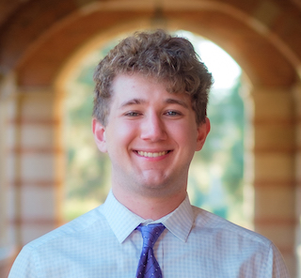
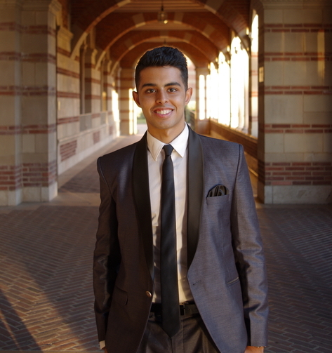
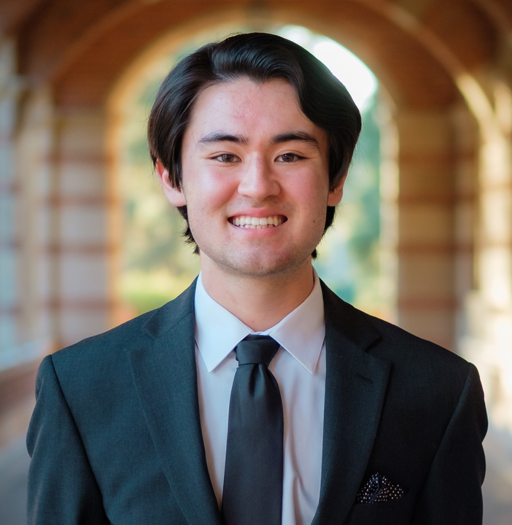
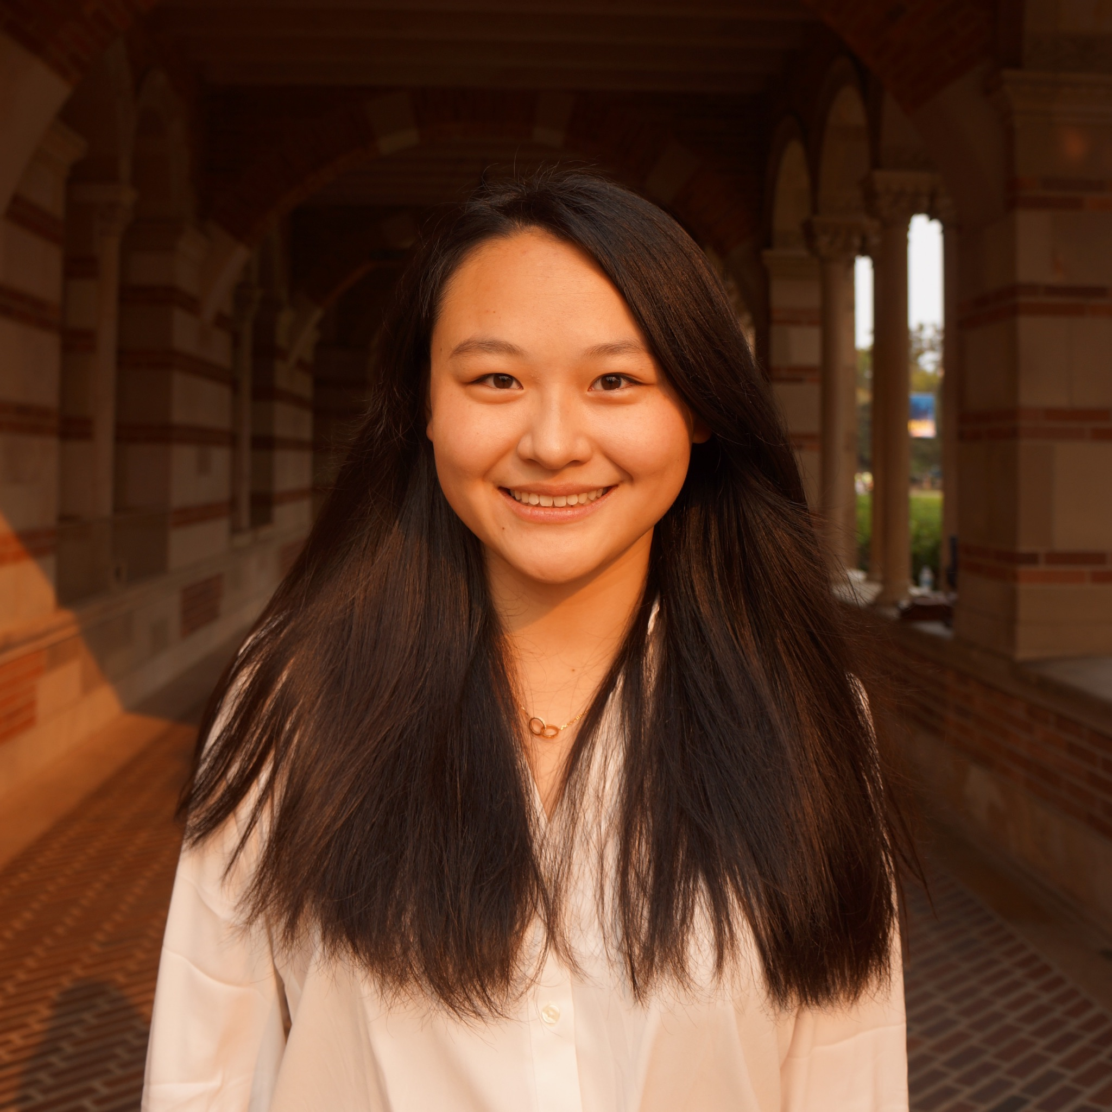
Meet the Norman Powell Student DataSquad
Vince Front
Project Manager
Shail Mirpuri
Data Science Consultant
Tristan Dewing
Data Science Consultant
Emily Gong
Technical Writer

Slide 3

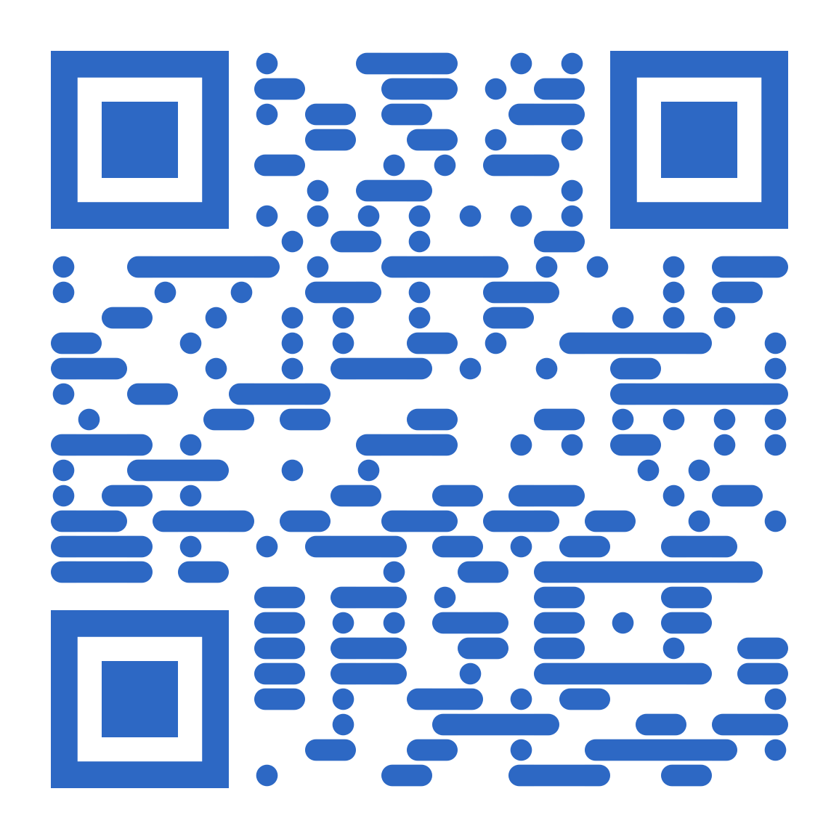
What Does DataSquad Do?
DataSquad is a team of undergraduate students who support data-related research at UCLA
Mission: to facilitate data processes for sustainable, replicable, and reproducible research, and workflows
UCLA DataSquad was made possible with a generous gift from Norman Powell
Contact the UCLA DataSquad:
https://ucla-datasquad.github.io/

Slide 4
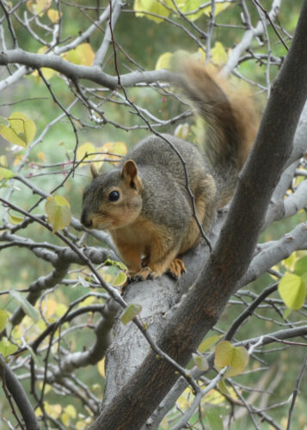

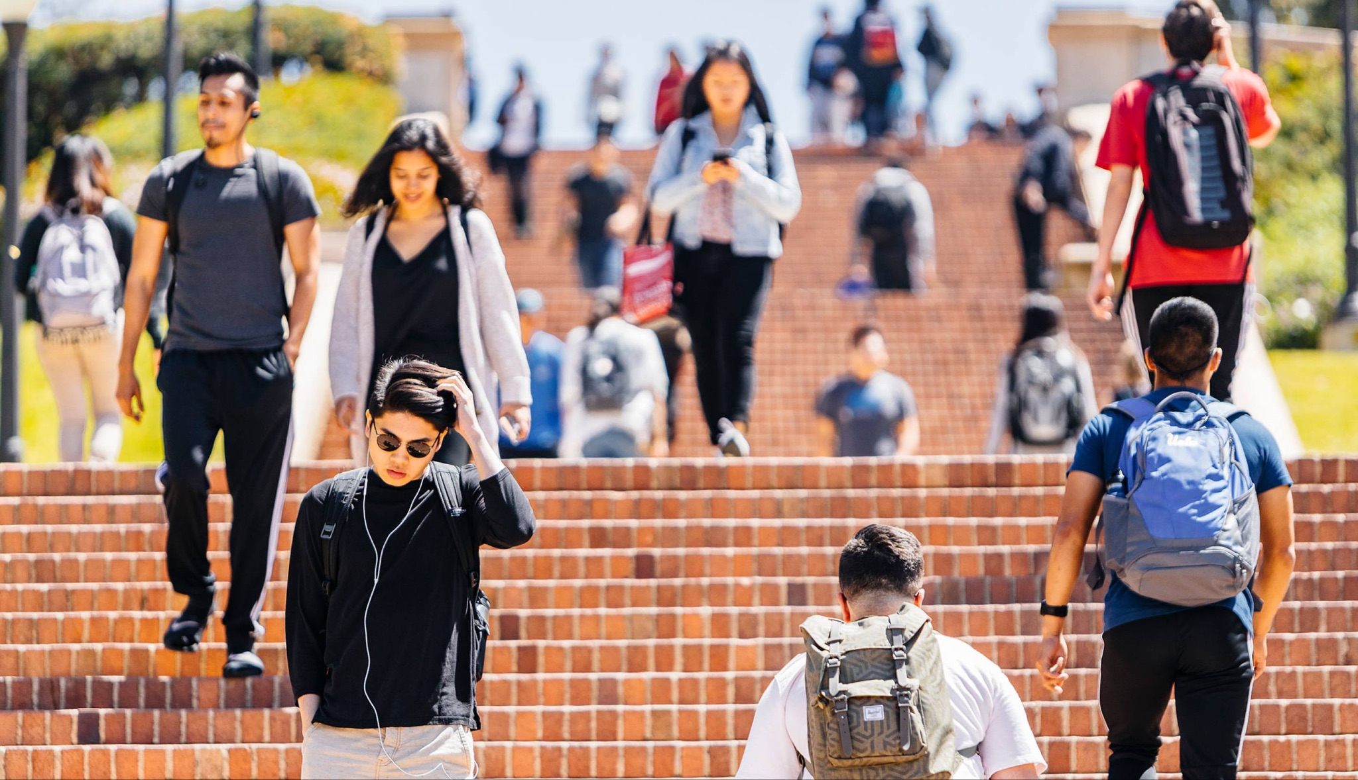
What DataSquad Has Worked On
Long-Term Research Projects
Converting surveys completed by Orang Asli Community of Malaysia to data tables
Tracking and predicting the behavior of squirrels
Converting centuries-long historical records from a German village to data tables
Smaller Research Projects
Visualizations of California Student Data
How TikTok affects the sales of books
Analyzing Scholarships for Undocumented Students

